Slide 1
AI chat-Voice & Gpt
Utilizing HTML and Python FastAPI for Effective Educational Tools
J.PHILIP-22173-CM-001
D.YASWANTH-22173-CM-004
P. MANISHA - 22173-CM-029
A.V.DURGA RAO-22173-CM-044
J.AJAY-22173-CM-049

Slide 2

Introduction
This project combines HTML for building the user interface and Python’s FastAPI for backend processing to create an AI voice assistant that helps users interact with educational content through voice and text.

Slide 3
Existing system
Include Google Assistant, Alexa, and Siri.
They are designed for general-purpose voice interaction.
Lack features specific to educational use.
Do not support file uploads or educational content processing.
No option to view or save chat history.
Limited in providing subject-specific or detailed academic responses.

Slide 4
01
UI Development

Slide 5
HTML Overview
HTML is used to design the user interface.
Pages include login, register, and chat interface.
Structures elements like buttons, input fields, and chat bubbles.
Provides layout for voice input, file upload, and theme toggle.
Acts as the front-facing part users interact with.

Slide 6

Limitations
Not fully responsive.
No accessibility support.
Basic error messages.
Limited animations.
No theme or language options.
Simple design, no modern CSS frameworks.
Limited form validation.

Slide 7
02
Server-Side Logic

Slide 8
FastAPI overview
FastAPI handles the backend logic of the app.
Manages user login, registration, and chat processing.
Connects with the Groq API to get AI responses.
Handles file uploads and stores chat history.
Provides fast and efficient API communication between frontend and AI.

Slide 9

Limitations
Uses local JSON files instead of a database.
No user session management or authentication tokens.
Limited error handling for API failures.
No real-time communication (like WebSockets).
Lacks scalability for multiple users.
No logging or monitoring system.
API key is stored in .env but not fully secured.

Slide 10
Disadvantages
Advantages
Easy-to-use interface.
Voice and text input supported.
Fast responses using FastAPI.
File upload for AI processing.
Chat history is saved.
Simple and lightweight design.
Helpful for educational use.
Needs internet.
Only .txt files supported.
English only.
No database.
Basic security.
Simple UI.
Limited error handling.
Single-user focus.
-------------------------------------

Slide 11
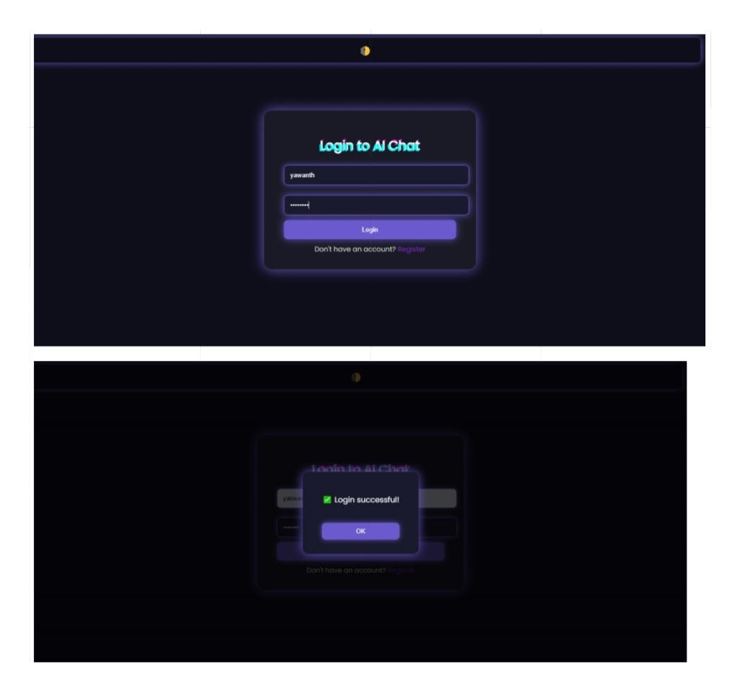
Output screens

Slide 12
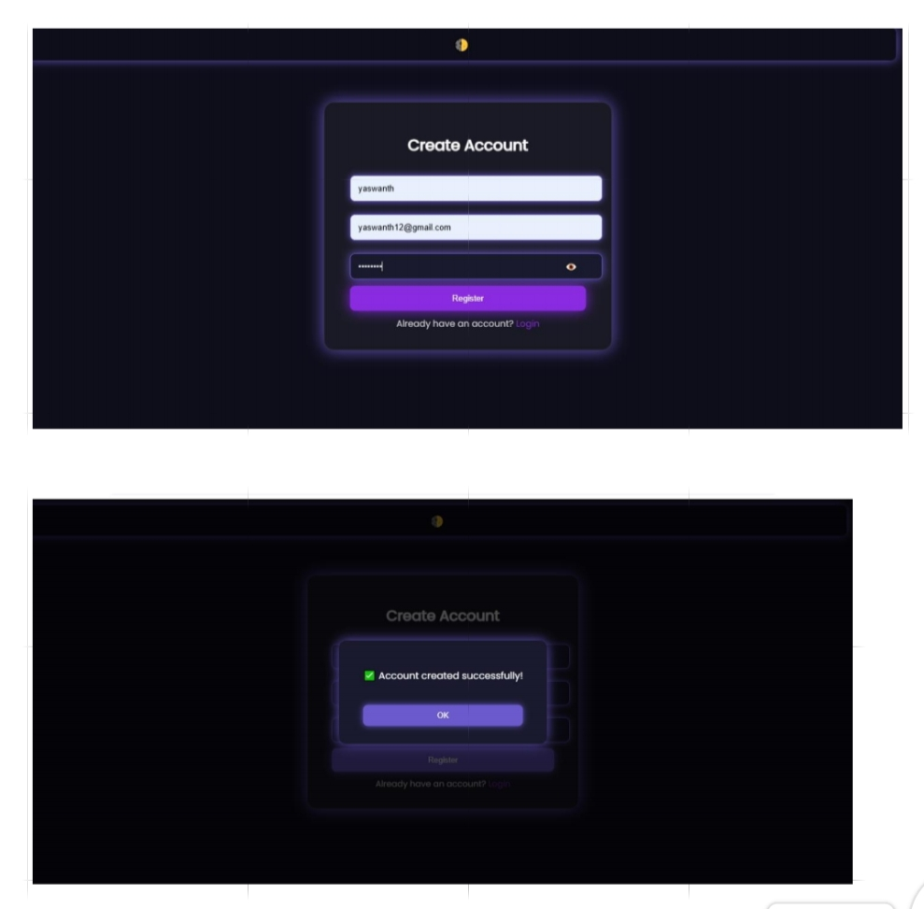

Slide 13
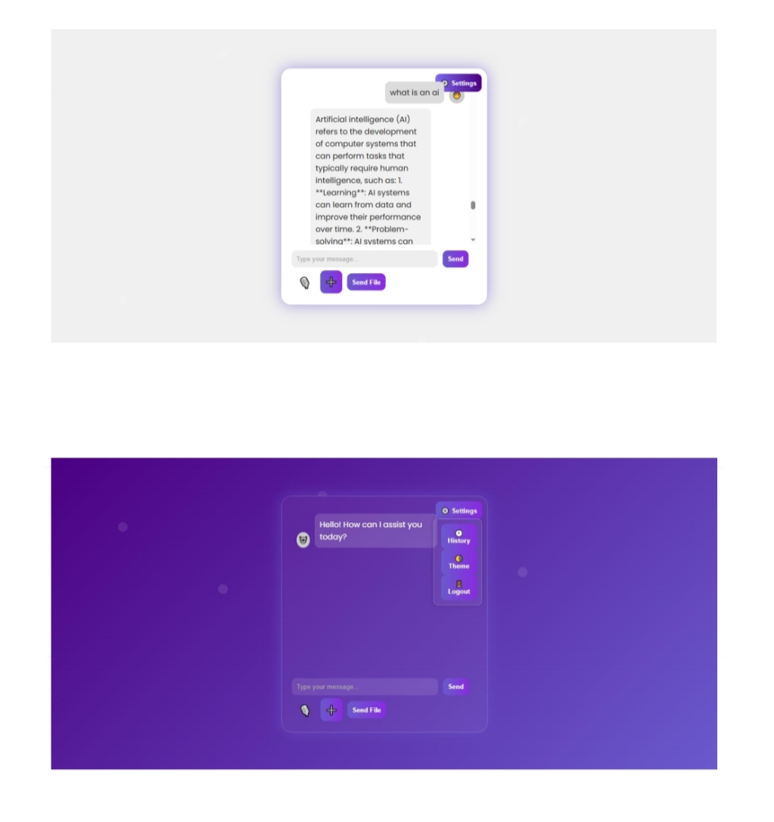

Slide 14
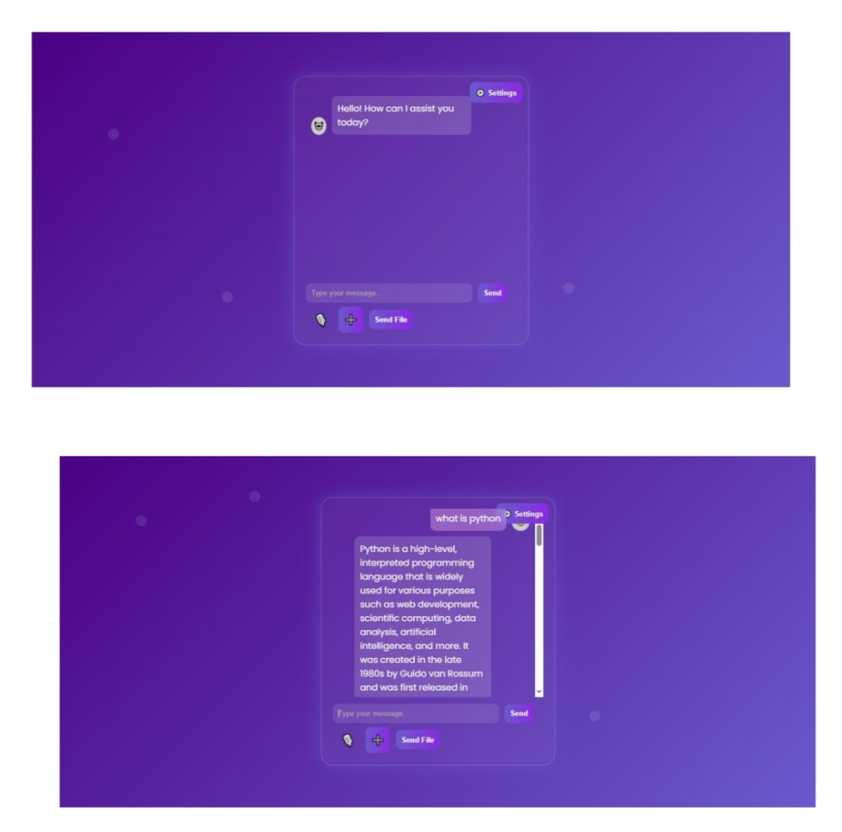

Slide 15
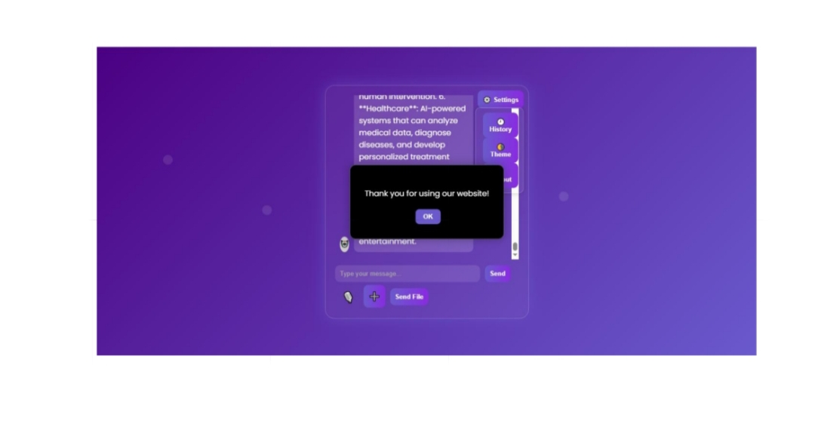

Slide 16

Conclusions
In summary, the combination of HTML for UI development and FastAPI for backend processes creates a powerful framework for AI voice assistants in education. These technologies work synergistically to enhance user engagement, performance, and scalability, ultimately providing a robust learning environment. By integrating advanced voice technologies, educational tools can cater effectively to diverse learning needs and preferences.

Slide 17
Future Work
Add support for multiple file types (PDF, DOC).
Implement database integration (e.g., MySQL, MongoDB).
Enable multi-language support.
Improve UI responsiveness and accessibility.
Add role-based access (admin/user).
Enhance security with JWT authentication.
Add real-time chat using WebSockets.
Train a custom AI model for subject-specific responses.

Slide 18
Thank you !

